Slide 1

Property-based testing Rebel semantics in the generated code
Master Software Engineering
Alex Kok
Amsterdam • 12 October 2017

Slide 2
Contents
Context
Problem statement
Approach
Experiments
Results
Conclusion
Future work
Demo

Slide 3
Context
Lack of domain knowledge
Incorrect
Implicit
Out of date
Ambiguous
Rebel
Specification language
Financial domain
Banking products
Check, visualise and simulate
Code generation
Notes:
Large companies suffer from the lack of domain knowledge, caused by often incorrect, implicit, out of date, or ambiguous definitions.
This is what Rebel tries to solve for the financial domain.
Rebel is a Specification language in which you can specify banking products.
A Rebel specification can be checked, visualized and simulated by the Rebel tool chain.
The Rebel tool chain also provides generators, to generate a software system based on the Rebel specification.

Slide 4
Context
Creating on-brand graphs
Create your graphs much more easily and on-brand by using graph templates.
You can learn how to use them by watching the video tutorial on the intranet
https://intranet.ing.net/sites/AboutING-global/Pages/The-ING-brand-en.aspx
An example of a Rebel specification
module simple_account_small.Account
import simple_account_small.Library
specification Account {
fields {
accountNumber: IBAN @key
balance: Money
}
events {
openAccount[]
deposit[]
}
lifeCycle {
initial init -> opened: openAccount
opened -> opened: deposit
final opened
}
}
Notes:
An example of a Rebel specification
Left: Simple account specification, opened and deposit
Right: Implementation of the events

Slide 5
Context
Creating on-brand graphs
Create your graphs much more easily and on-brand by using graph templates.
You can learn how to use them by watching the video tutorial on the intranet
https://intranet.ing.net/sites/AboutING-global/Pages/The-ING-brand-en.aspx
An example of a Rebel specification
The event definitions
module simple_account_small.Account
import simple_account_small.Library
specification Account {
fields {
accountNumber: IBAN @key
balance: Money
}
events {
openAccount[]
deposit[]
}
lifeCycle {
initial init -> opened: openAccount
opened -> opened: deposit
final opened
}
}
module simple_account_small.Library
import simple_account_small.Account
event openAccount(initialDeposit: Money) {
preconditions {
initialDeposit >= EUR 0.00;
}
postconditions {
new this.balance ==
initialDeposit;
}
}
event deposit(amount: Money) {
// ...
}
Notes:
An example of a Rebel specification
Left: Simple account specification, opened and deposit
Right: Implementation of the events

Slide 6
Problem statement
Generating system
Implementation is not checked
Automatically
Solution
Property-based testing
Rebel semantics
Notes:
From a Rebel specification, a software system can be generated - (generated system)
However, the implementation of that system is not being checked.
We want to check the implementation automatically such that it requires less manual effort to test it.
Solution
We will use property-based testing to do this
We focus on the semantics of Rebel, these should also hold in the generated system

Slide 7
Problem statement
Main research question
How can the generator in the Rebel toolchain be tested automatically, by using the generated system, to check whether the implementation works as expected?
Sub research questions
Which properties are expected to hold on the semantics of the generated code?
How can we test each property as automatically as possible to find bugs in the generator?
What kind of bugs can be found using this approach and how many?
Notes:
Our main research question is as follows …
This contains some parts:
What is expected? > Focus on functionals, as with property-based testing we define properties that are expected to hold. Non-functionals will be harder to test
This is the first SRQ
Second, we want to do this automatically: So, how do we do that, which brings up the second SRQ
And we want to test the generated system, what bugs can we find and how many did we find?

Slide 8
Approach
Define expected properties
Axioms as inspiration
Reflexivity, Associativity, Distributivity, Symmetry, etc.
Rebel types and operators
Focus on Money
Create specification
Rebel syntax
Type checker
Implicative properties
Notes:
First we have to define the expected properties.
We have to define these ourselfes, as there were no defined properties for Rebel
We used the axioms of algebra as inspiration, think of Reflexivity …
Rebel introduces custom types like Money and allows operations on these. But not every combination is possible
Such as multiplying two Money values. What would be the value of Money squared?
Thats not supported in Rebel, the type checker prevents this
We focus on the Money type, as this is an important type for a back
Next, we create a Rebel specification with these properties.
Due to the strong syntax of Rebel, we can write these properties down as events in a Rebel specification
These are checked by the type checker too now
We use the naming “implicative properties” to describe a property that uses the implication symbol. Such as Symmetry
Here, we can see the event definition of Account again. However, our new specification would use the property names as eventNames, and the implementation describes the property

Slide 9
Approach
Define expected properties
Axioms as inspiration
Reflexivity, Associativity, Distributivity, Symmetry, etc.
Rebel types and operators
Focus on Money
Create specification
Rebel syntax
Type checker
Implicative properties
event openAccount(initialDeposit: Money) {
preconditions {
initialDeposit >= EUR 0.00;
}
postconditions {
new this.balance ==
initialDeposit;
}
}
Notes:
First we have to define the expected properties.
We have to define these ourselfes, as there were no defined properties for Rebel
We used the axioms of algebra as inspiration, think of Reflexivity …
Rebel introduces custom types like Money and allows operations on these. But not every combination is possible
Such as multiplying two Money values. What would be the value of Money squared?
Thats not supported in Rebel, the type checker prevents this
We focus on the Money type, as this is an important type for a back
Next, we create a Rebel specification with these properties.
Due to the strong syntax of Rebel, we can write these properties down as events in a Rebel specification
These are checked by the type checker too now
We use the naming “implicative properties” to describe a property that uses the implication symbol. Such as Symmetry
Here, we can see the event definition of Account again. However, our new specification would use the property names as eventNames, and the implementation describes the property

Slide 10
Approach
Define expected properties
Axioms as inspiration
Reflexivity, Associativity, Distributivity, Symmetry, etc.
Rebel types and operators
Focus on Money
Create specification
Rebel syntax
Type checker
Implicative properties
event reflexiveEquality(x: Money) {
postconditions {
new this.result ==
( x == x );
}
}
event symmetric(x: Money, y: Money) {
postconditions {
new this.result ==
( (x == y) ? y == x : True );
}
}
event openAccount(initialDeposit: Money) {
preconditions {
initialDeposit >= EUR 0.00;
}
postconditions {
new this.balance ==
initialDeposit;
}
}
Notes:
First we have to define the expected properties.
We have to define these ourselfes, as there were no defined properties for Rebel
We used the axioms of algebra as inspiration, think of Reflexivity …
Rebel introduces custom types like Money and allows operations on these. But not every combination is possible
Such as multiplying two Money values. What would be the value of Money squared?
Thats not supported in Rebel, the type checker prevents this
We focus on the Money type, as this is an important type for a back
Next, we create a Rebel specification with these properties.
Due to the strong syntax of Rebel, we can write these properties down as events in a Rebel specification
These are checked by the type checker too now
We use the naming “implicative properties” to describe a property that uses the implication symbol. Such as Symmetry
Here, we can see the event definition of Account again. However, our new specification would use the property names as eventNames, and the implementation describes the property

Slide 11
Approach
Test each event (property)
Test framework
3 experiments
Notes:
Now that we have a Rebel specification, we want to test each event in it
(Which are basically the properties, but we call them events when we talk about the ones in the Rebel specification that we created
We have done 3 experiments in total, which some increments to the Test Framework in each experiment
Overview:

Slide 12
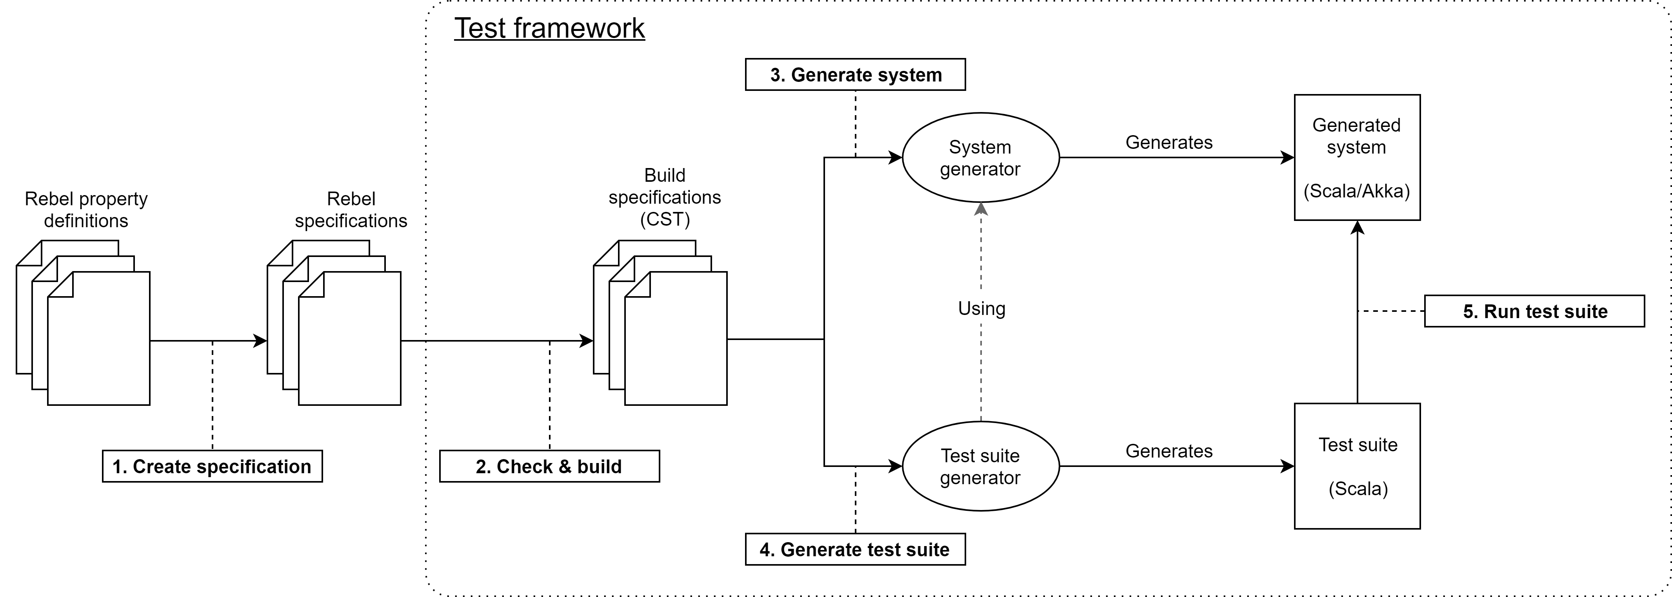
Approach
Test each event (property)
Test framework
3 experiments
Notes:
Now that we have a Rebel specification, we want to test each event in it
(Which are basically the properties, but we call them events when we talk about the ones in the Rebel specification that we created
We have done 3 experiments in total, which some increments to the Test Framework in each experiment
Overview:

Slide 13
Experiments
First experiment
Random input values
Test 100 times
Errors
Precision errors (5x)
Over/underflow errors (2x)
Compilation error (1x)
DistributiveInteger2
Notes:
The first experiment consists of using random input values, and testing each property 100 times
We have found 8 errors, precision, over/underflow errors, and a compilation error.
Compilation errors were initially left out of scope due to the causes can be hard to identify.
However, this compilation error occured when using a property that we expected to hold. So it is relevant now
When a test fails, it shows the input values with how it failed, such that it can be reproduced
For each error we setup a table and do the intermediate calculations
Here, you can see that theres a precision error when multiplying an Integer with the Money type.
This error was related to the implemenation of the Money type, for which an open-source library was used in the implementation, called Squants

Slide 14
Experiments
First experiment
Random input values
Test 100 times
Errors
Precision errors (5x)
Over/underflow errors (2x)
Compilation error (1x)
DistributiveInteger2
Variable | Value | Type
x | -883022216 | Integer
y | -298435082.93 EUR | Money
z | 715725888.96 EUR | Money
Formula | Scala result | Expected result
(y+z)*x == y*x + z*x | false | true
(y+z)*x | -368477052257036740 EUR | -368477052257036762.48 EUR
y*x + z*x | -368477052257036796 EUR | -368477052257036762.48 EUR
y+z | 417290806.03 EUR | 417290806.03 EUR
y*x | 263524808260992384 EUR | 263524808260992372.88 EUR
z*x | -632001860518029180 EUR | -632001860518029135.36 EUR
Notes:
The first experiment consists of using random input values, and testing each property 100 times
We have found 8 errors, precision, over/underflow errors, and a compilation error.
Compilation errors were initially left out of scope due to the causes can be hard to identify.
However, this compilation error occured when using a property that we expected to hold. So it is relevant now
When a test fails, it shows the input values with how it failed, such that it can be reproduced
For each error we setup a table and do the intermediate calculations
Here, you can see that theres a precision error when multiplying an Integer with the Money type.
This error was related to the implemenation of the Money type, for which an open-source library was used in the implementation, called Squants

Slide 15
Experiments
Notes:
So we created an issue
And it was fixed within a day, thus we collaborated on an open-source library

Slide 16
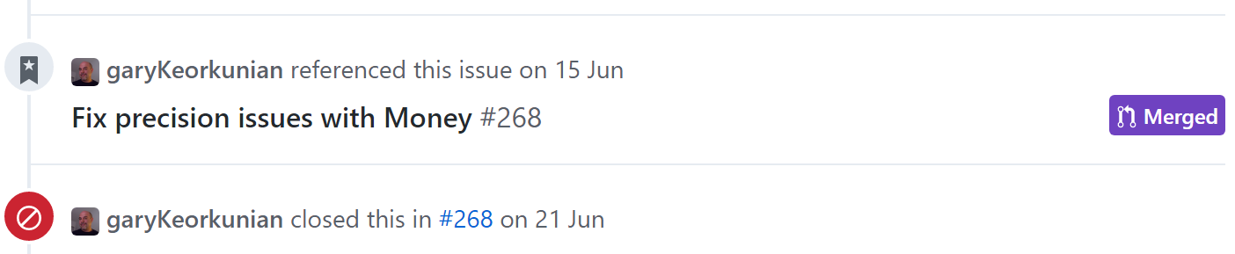

Experiments
Notes:
So we created an issue
And it was fixed within a day, thus we collaborated on an open-source library

Slide 17
Experiments
Random values
Implicative properties
Condition
Symmetric: x == y -> y == x
Value generator
Fixed values
Mutating
case Symmetric(x, y) => { checkPostCondition((
nextData.get.result.get == ((
if ((x == y)) y == x else True
))
), "new this.result ==
( (x == y) ? y == x : True )") }
Notes:
Problem with random values: Implicative property coverage
Random values often do not satisfy the condition it checks for. Thus: else-clause
We created a value generator in the test framework to generate values satisfying the conditions.
The result of the value generator will be a list of values, but these are fixed values now.
Thus, we mutate the values with a random operation inside the test cases, to make it random again.

Slide 18
Experiments
First value generator
Not very dynamic
Implicative properties
Update
Add preconditions
Value generator
Additional properties
event symmetric(x: Money, y: Money) {
preconditions {
x == y;
}
postconditions {
new this.result ==
( (x == y) ? y == x : False );
}
}
event transitiveEquality(x: Money, y: Money, z: Money) {
preconditions {
x == y;
y == z;
}
postconditions {
new this.result ==
( (x == y && y == z) ? x == z : False );
}
}
Notes:
Last version was better than first version of value generator.
We now use the statements in the precondition block to generate the values.
We also added additional properties to show that it does not require modifications on the test suite anymore per implicative property. This was the case in E2

Slide 19
Experiments
Value generator
Known | Assign | Determine | Check & assign
- | x = 1 | y = 1 (y = x) | -
- | x = 1 | y.min = 1 (y > x) | y = 5
- | y = 2 z = 3 | x = 6 (x = 2*3) | -
- | x = 1 | y.min = 1 (y > x) | y = 5
y = 5 | - | z.min = 5 (z > y) | z = 10
Equality
( x == y )
Inequality
( x < y )
Expression
( x == y * z )
Combination
( x < y
&&
y < z )
Notes:
So how does the value generator work with these precondition statements?

Slide 20
Results
Set of property definitions
Incomplete
Incorrect
Error categories
Precision errors
Overflow/underflow errors
Compilation errors

Slide 21
Conclusion
Not fully automatic
Create specification
Test framework
Multiple generators
Value generator limitations
Expressions
Assumptions
Expectations
Others that invalidate a property
Operator implementations
Generator translation errors

Slide 22
Future work
Complete set of properties
Every type
Combinations
Multiple generators

Slide 23
Demo

Slide 24
Thank you

